Slide 1
Advanced Database Management Systems (CSC-234)
The Mongo Aggregation Framework

Slide 2
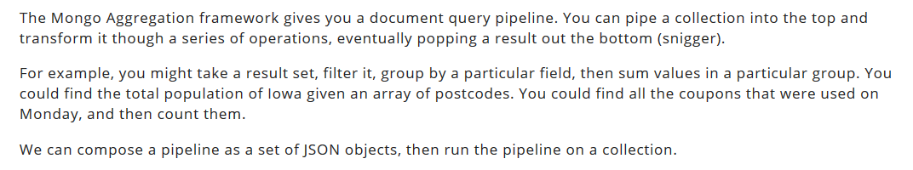

Slide 3
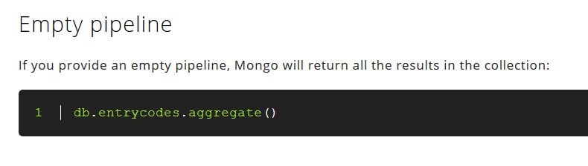

Slide 4
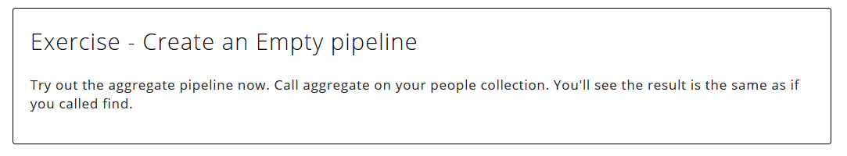

Slide 5
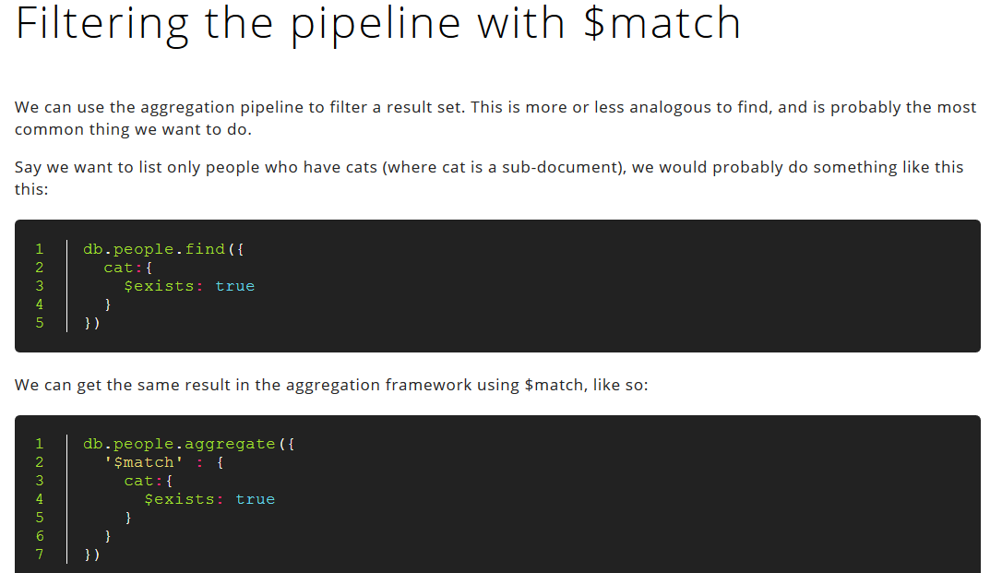

Slide 6
So why use aggregation over find? In this example they are the same, but the power comes when we start to chain additional functions as we shall soon see.

Slide 7
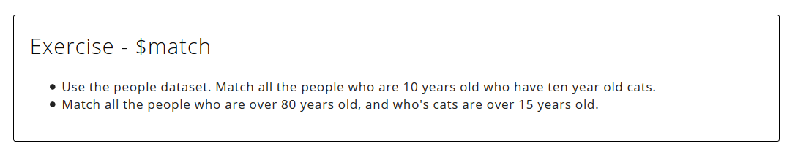

Slide 8
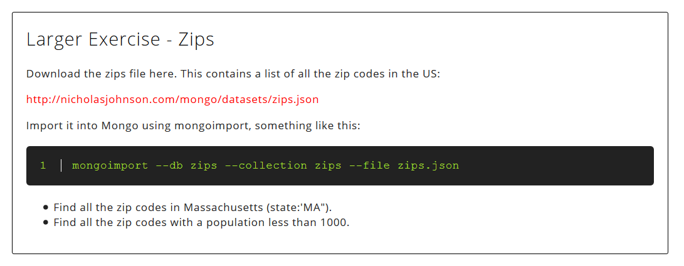
http://nicholasjohnson.com/mongo/datasets/zips.json

Slide 9
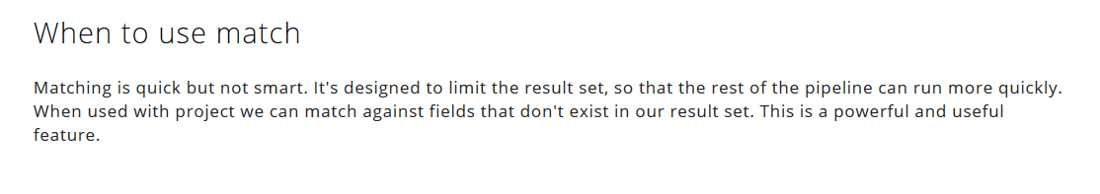

Slide 10
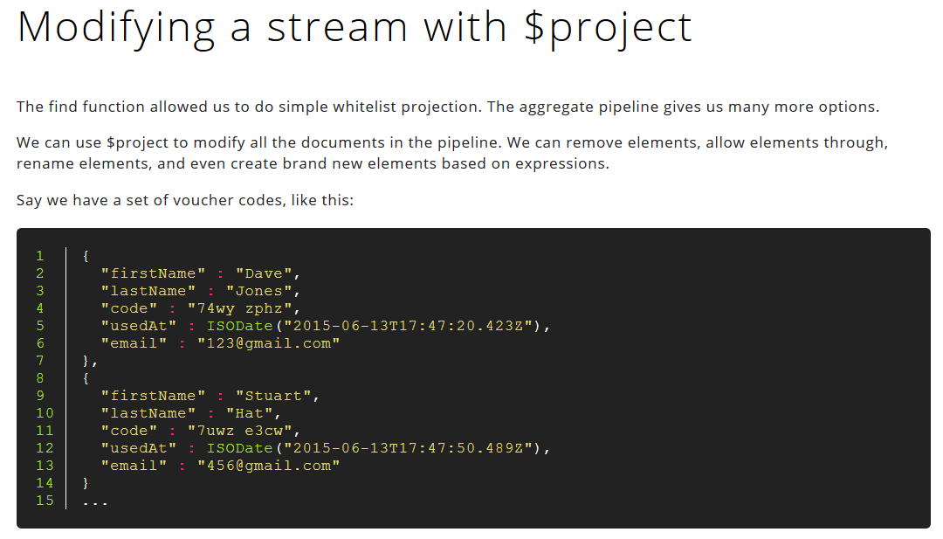

Slide 11
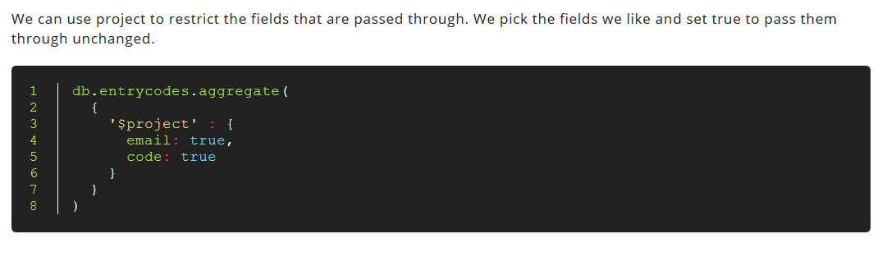

Slide 12
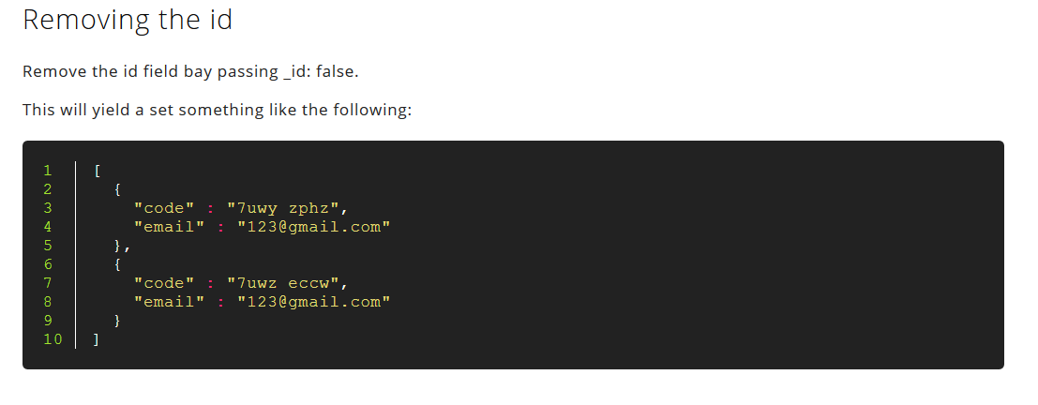

Slide 13
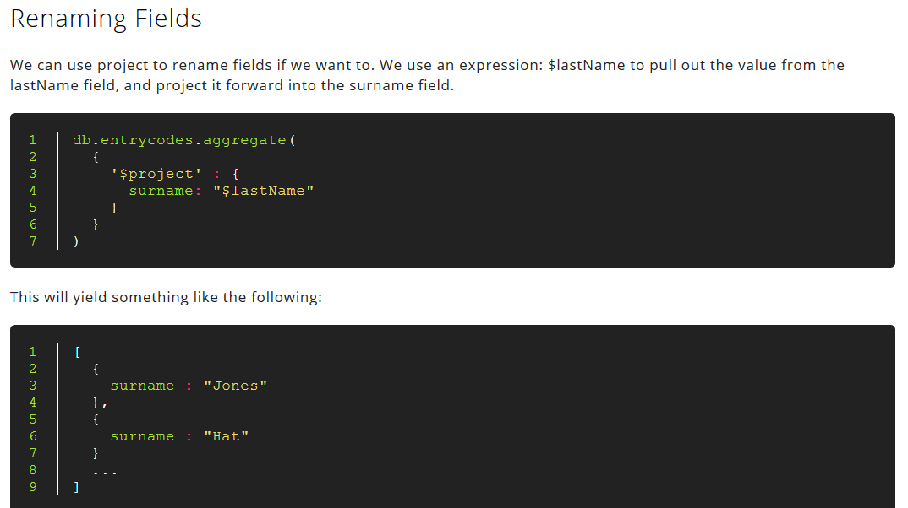

Slide 14
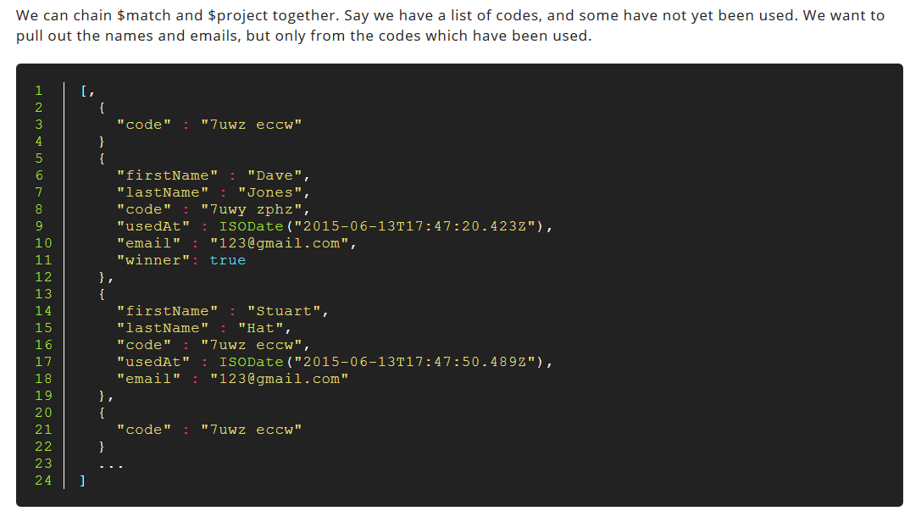
Chaining match and project

Slide 15
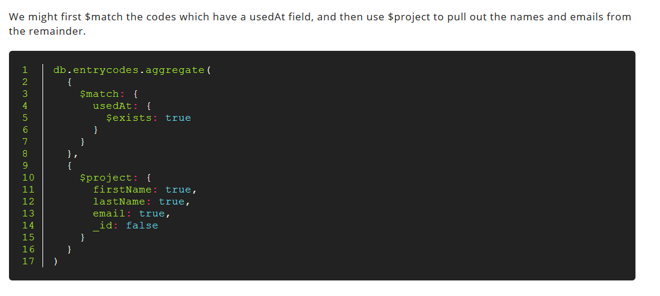

Slide 16
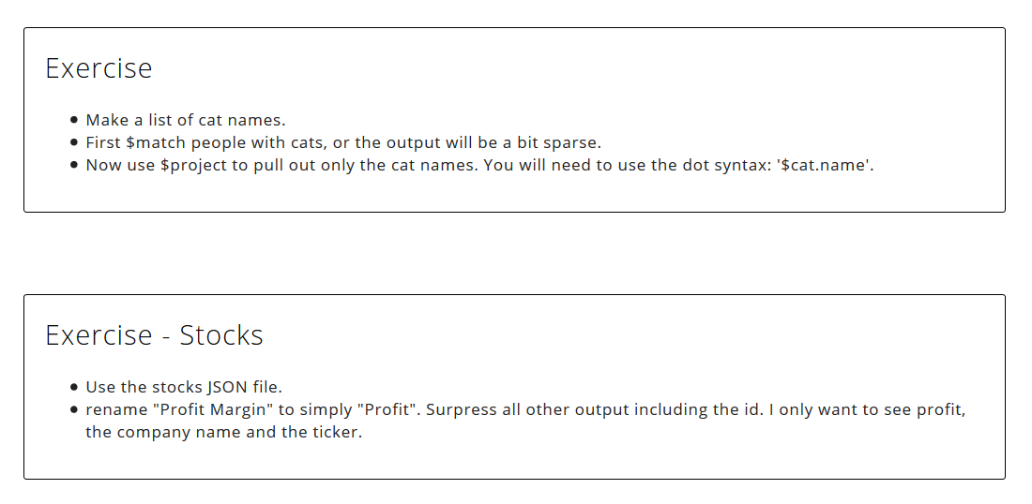

Slide 17
Lecture content adapted from https://docs.mongodb.com/manual/ & http://nicholasjohnson.com/mongo/course/workbook/

